Slide 1
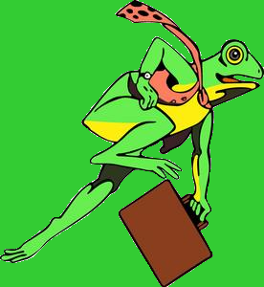
ANTI - Frogger

Slide 2
ANTI - Frogger
Single player side-scrolling driving game based on the arcade classic Frogger but in reverse
Wildlife Committee:
Dalton Navalta
dnavalta@live.com
Bryan Kline
bryan_kline@mail.tmcc.edu

Slide 3
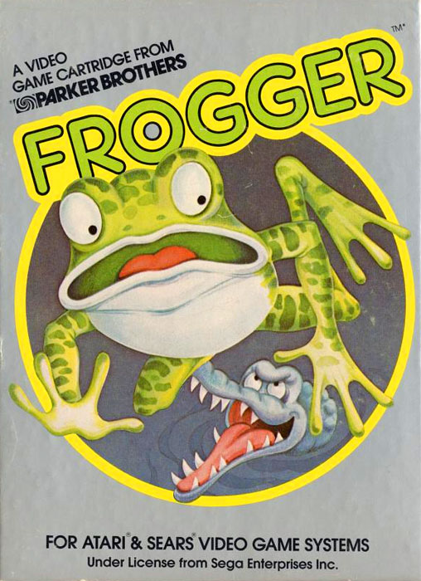
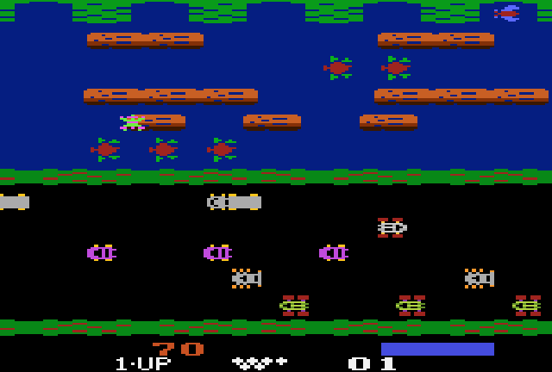
ANTI - Frogger
Frogger was developed in 1981
by Konami and licensed in the US
by Sega-Gremlin

Slide 4
ANTI - Frogger
Implemented in HTML and Javascript
Three levels: Lakeside, Forrest, and Beach
Game difficulty increases with levels
Graphics and sound from original Frogger
Satisfies 2D array constraint with a dynamic 2D array which manages the objects of the game

Slide 5
ANTI - Frogger
Accomplishments
Increased understanding of Javascript and canvas
Further exposure to Object Oriented Programming and the dynamic instantiation of objects
Coordinating tasks between group members and developing modular code

Slide 6
ANTI - Frogger
Challenges
Object instantiation in 2D array
Update function and timing
Level change and level menu timing
Scene scrolling

Slide 7
ANTI - Frogger Acknowledgments
Frogger by Konami – graphics, sound, and concept
Zelda by Nintendo – graphics
wikipedia.com – Frogger history
videogamecritic.com/arcadeartlibrary.com – graphics
JQuery – keypress library
freesound.org – sounds

